Slide 1

Chapter 21
Network Layer:
Address Mapping,
Error Reporting,
and Multicasting
21.<number>
Copyright © The McGraw-Hill Companies, Inc. Permission required for reproduction or display.

Slide 2
21-1 ADDRESS MAPPING
The delivery of a packet to a host or a router requires two levels of addressing: logical and physical. We need to be able to map a logical address to its corresponding
physical address and vice versa. This can be done by using either static or dynamic mapping.
Topics discussed in this section:
Mapping Logical to Physical Address
Mapping Physical to Logical Address
21.<number>

Slide 3

Figure 21.1 Mapping Logical to Physical Address
ARP (address resolution protocol)
21.<number>

Slide 4

Note
ARP can be useful if the ARP reply is cached (kept in cache memory for a while).
21.<number>

Slide 5

Figure 21.2 ARP packet
21.<number>

Slide 6
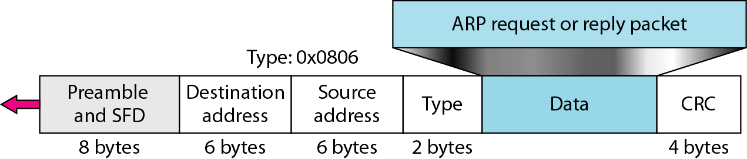
Figure 21.3 Encapsulation of ARP packet
21.<number>

Slide 7

Figure 21.4 Four cases using ARP
21.<number>

Slide 8
Note
An ARP request is broadcast;
an ARP reply is unicast.
21.<number>

Slide 9
Example 21.1
A host with IP address 130.23.43.20 and physical address B2:34:55:10:22:10 has a packet to send to another host with IP address 130.23.43.25 and physical address A4:6E:F4:59:83:AB. The two hosts are on the same Ethernet network. Show the ARP request and reply packets encapsulated in Ethernet frames.
Solution
Figure 21.5 shows the ARP request and reply packets. Note that the ARP data field in this case is 28 bytes, and that the individual addresses do not fit in the 4-byte boundary. That is why we do not show the regular 4-byte boundaries for these addresses.
21.<number>

Slide 10

Figure 21.5 Example 21.1, an ARP request and reply
21.<number>

Slide 11

Figure 21.6 Proxy ARP
21.<number>

Slide 12
Mapping Phy to Logical Address: RARP, BOOTP, and DHCP
A diskless station just booted.
An organization does not have enough IP addresses to assign to each station.
21.<number>

Slide 13
Reverse Address Resolution Protocol (ARP)
A machine can use the phy address to get the logical address using RARP.
A RARP messages is created and brodcast on the local network.
The machine on the local network that knows the logical address will respond with a RARP reply.
Broadcasting is done at data link layer.
Broadcast requests does not pass the boundaries of a network.
21.<number>

Slide 14
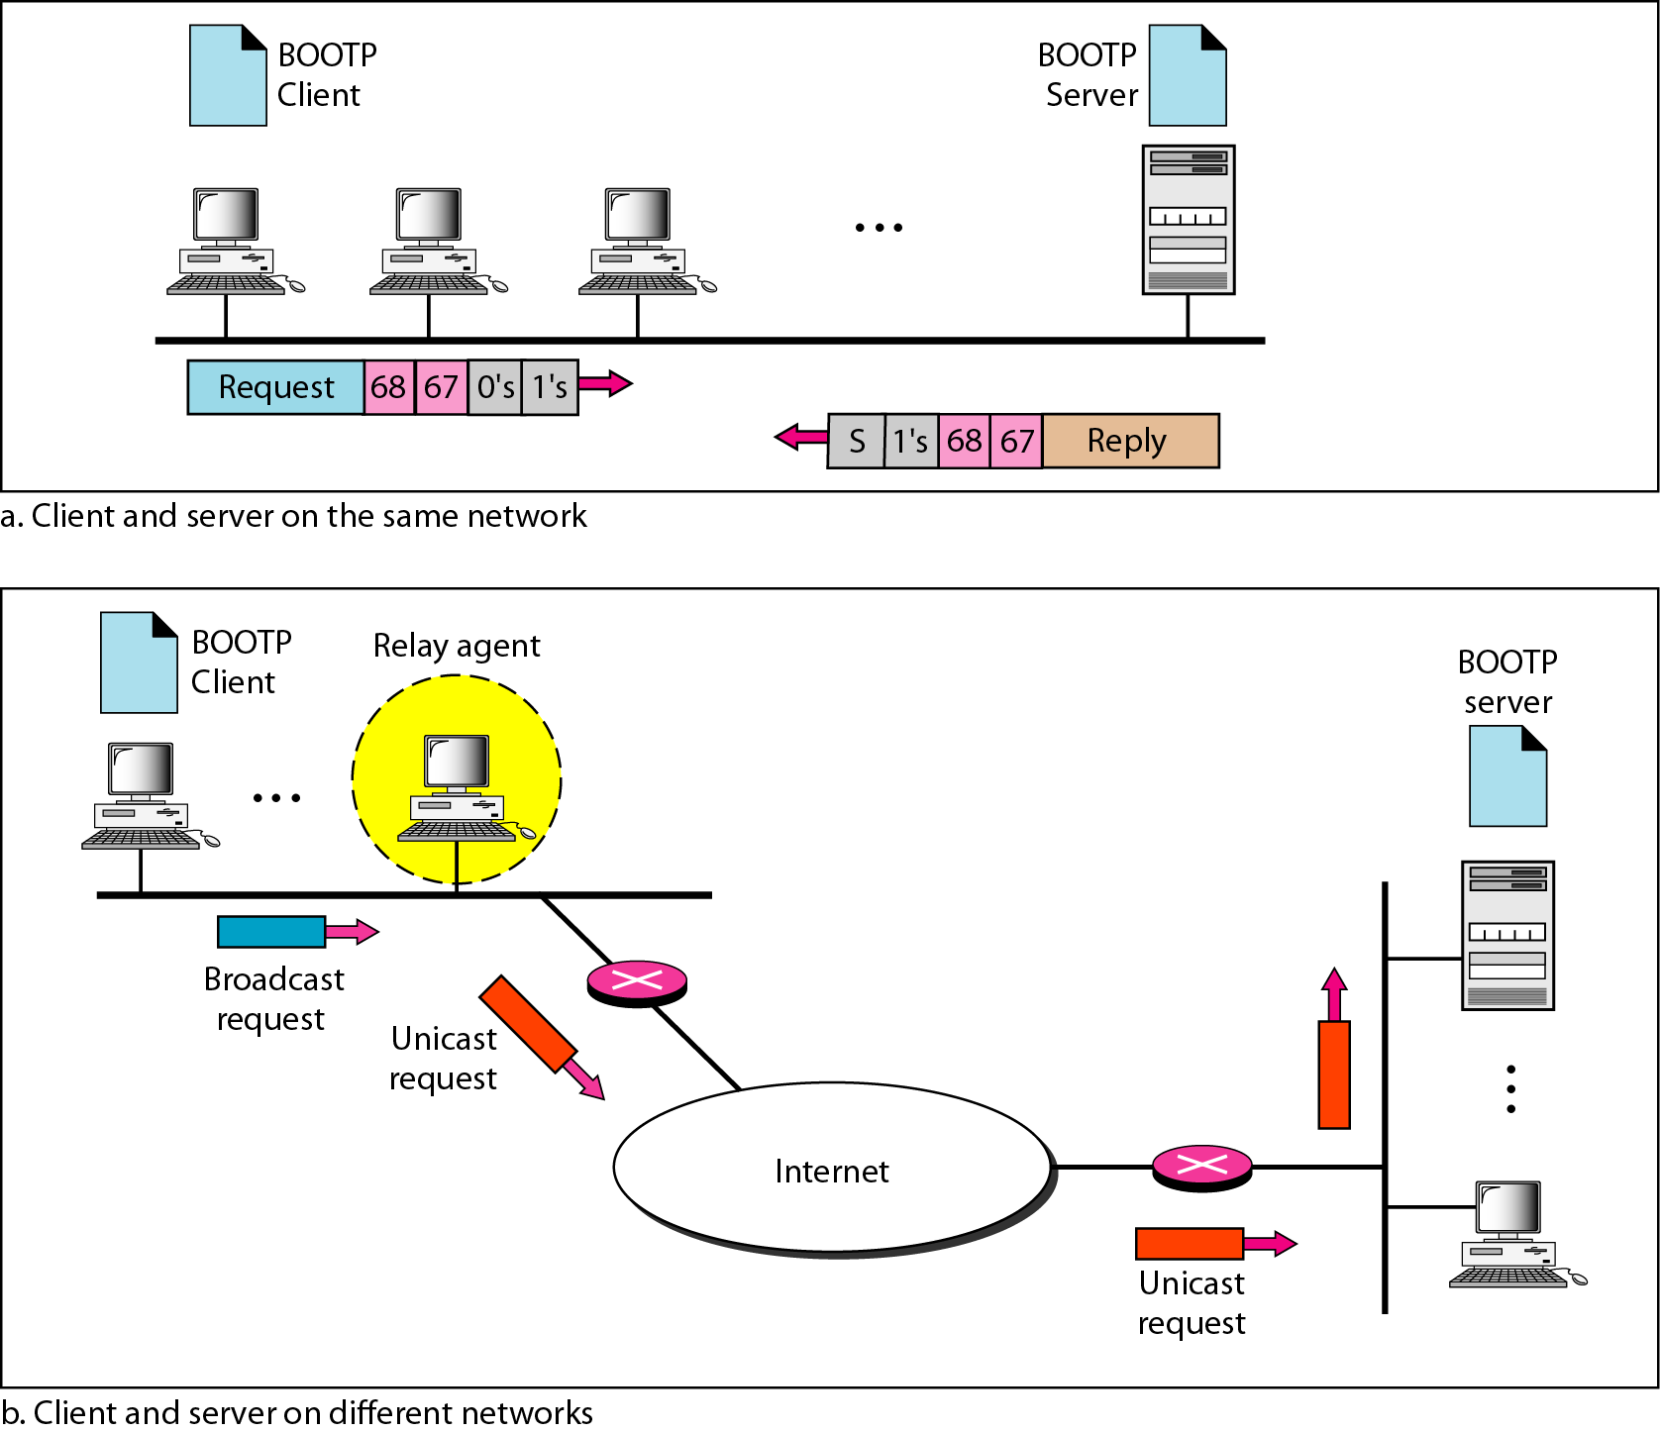
Figure 21.7 BOOTP client and server on the same and different networks
21.<number>

Slide 15
Note
DHCP provides static and dynamic address allocation that can be
manual or automatic.
21.<number>

Slide 16
DHCP: Dynamic Host Configuration Protocol
Goal: allow host to dynamically obtain its IP address from network server when it joins network
  Can renew its lease on address in use
  Allows reuse of addresses (only hold address while connected an “on”
  Support for mobile users who want to join network (more shortly)
DHCP overview:
  host broadcasts “DHCP discover” msg
  DHCP server responds with “DHCP offer” msg
  host requests IP address: “DHCP request” msg
  DHCP server sends address: “DHCP ack” msg

Slide 17



DHCP client-server scenario
A
223.1.1.1
DHCP
223.1.2.1
server
223.1.1.2
223.1.1.4
223.1.2.9
B
223.1.2.2
E
arriving DHCP
client needs
address in this
network
223.1.1.3
223.1.3.27
223.1.3.1
223.1.3.2

Slide 18
DHCP client-server scenario
DHCP server: 223.1.2.5
arriving
client
DHCP discover
src : 0.0.0.0, 68
dest.: 255.255.255.255,67
yiaddr: 0.0.0.0
transaction ID: 654
DHCP offer
src: 223.1.2.5, 67
dest: 255.255.255.255, 68
yiaddrr: 223.1.2.4
transaction ID: 654
Lifetime: 3600 secs
DHCP request
src: 0.0.0.0, 68
dest:: 255.255.255.255, 67
yiaddrr: 223.1.2.4
transaction ID: 655
Lifetime: 3600 secs
time
DHCP ACK
src: 223.1.2.5, 67
dest: 255.255.255.255, 68
yiaddrr: 223.1.2.4
transaction ID: 655
Lifetime: 3600 secs

Slide 19
21-2 ICMP
The IP protocol has no error-reporting or error-correcting mechanism. The IP protocol also lacks a mechanism for host and management queries. The Internet Control Message Protocol (ICMP) has been designed to compensate for the above two deficiencies. It is a companion to the IP protocol.
Topics discussed in this section:
Types of Messages
Message Format
Error Reporting and Query
Debugging Tools
21.<number>

Slide 20

Figure 21.8 General format of ICMP messages
21.<number>

Slide 21
Note
ICMP always reports error messages to the original source.
21.<number>

Slide 22
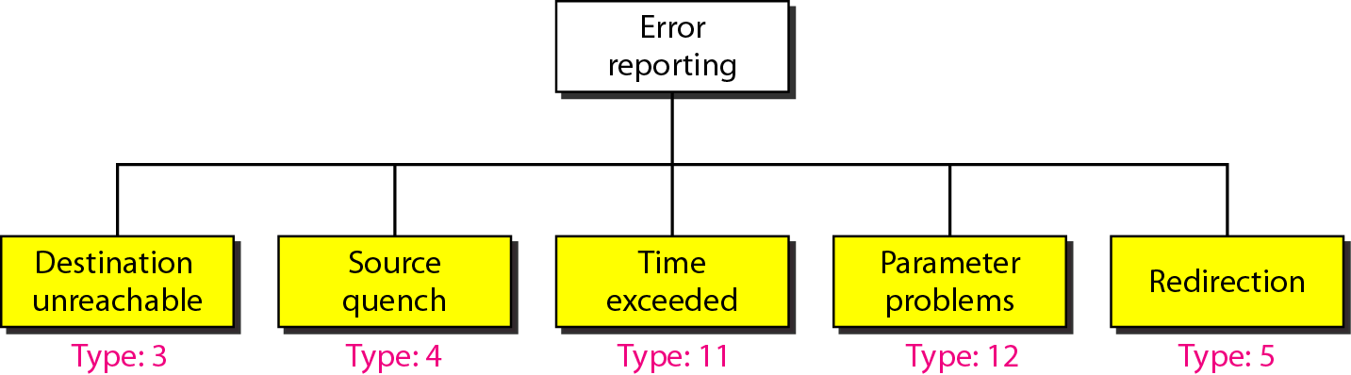
Figure 21.9 Error-reporting messages
21.<number>

Slide 23
Note
Important points about ICMP error messages:
❏ No ICMP error message will be generated in
response to a datagram carrying an ICMP error
message.
❏ No ICMP error message will be generated for a
fragmented datagram that is not the first fragment.
❏ No ICMP error message will be generated for a
datagram having a multicast address.
❏ No ICMP error message will be generated for a
datagram having a special address such as
127.0.0.0 or 0.0.0.0.
21.<number>

Slide 24
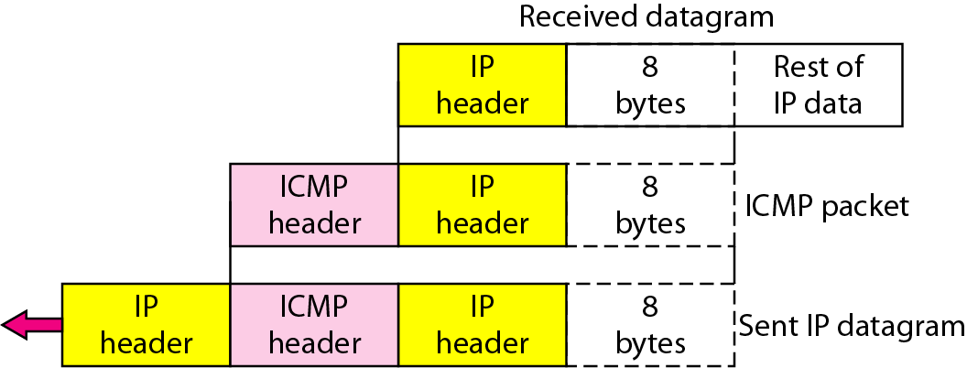
Figure 21.10 Contents of data field for the error messages
21.<number>

Slide 25

Figure 21.12 Query messages
21.<number>

Slide 26
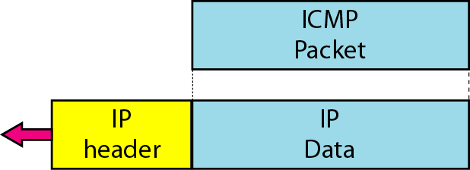
Figure 21.13 Encapsulation of ICMP query messages
21.<number>

Slide 27
Example 21.2
Figure 21.14 shows an example of checksum calculation for a simple echo-request message. We randomly chose the identifier to be 1 and the sequence number to be 9. The message is divided into 16-bit (2-byte) words. The words are added and the sum is complemented. Now the sender can put this value in the checksum field.
21.<number>

Slide 28
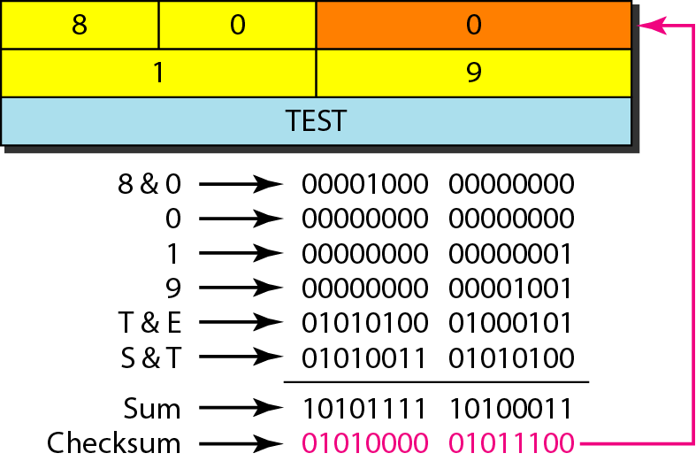
Figure 21.14 Example of checksum calculation
21.<number>

Slide 29
Example 21.3
We use the ping program to test the server fhda.edu. The result is shown on the next slide. The ping program sends messages with sequence numbers starting from 0. For each probe it gives us the RTT time. The TTL (time to live) field in the IP datagram that encapsulates an ICMP
message has been set to 62. At the beginning, ping defines the number of data bytes as 56 and the total number of bytes as 84. It is obvious that if we add 8 bytes of ICMP header and 20 bytes of IP header to 56, the result is 84. However, note that in each probe ping defines the number of bytes as 64. This is the total number of bytes in the ICMP packet (56 + 8).
21.<number>

Slide 30
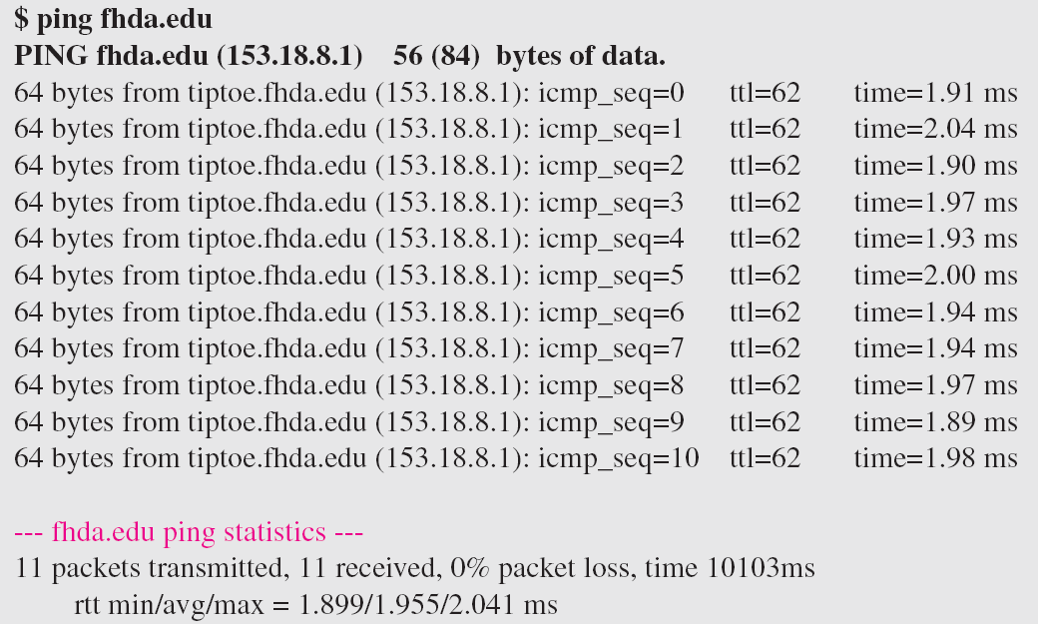
Example 21.3 (continued)
21.<number>

Slide 31
21.<number>

Slide 32
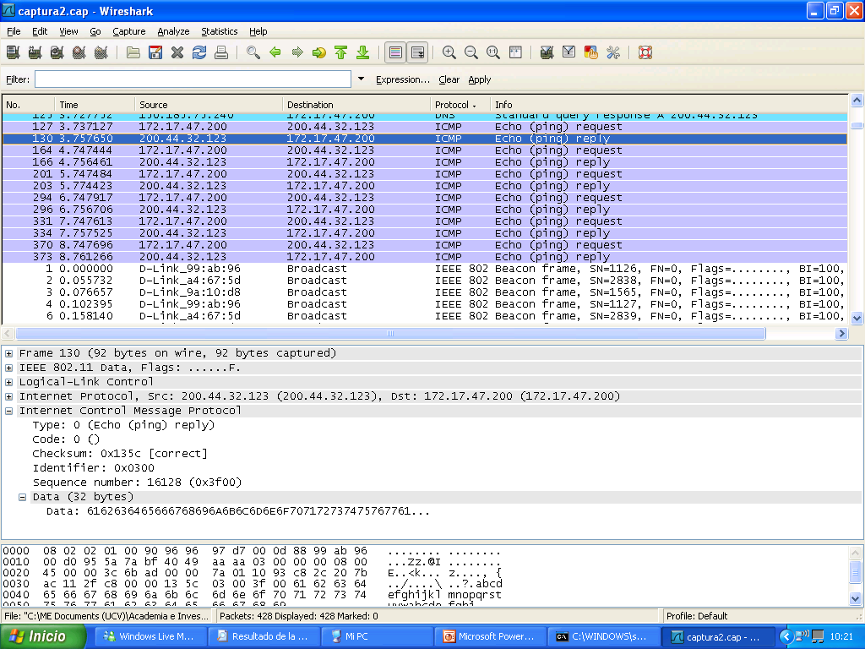
21.<number>

Slide 33
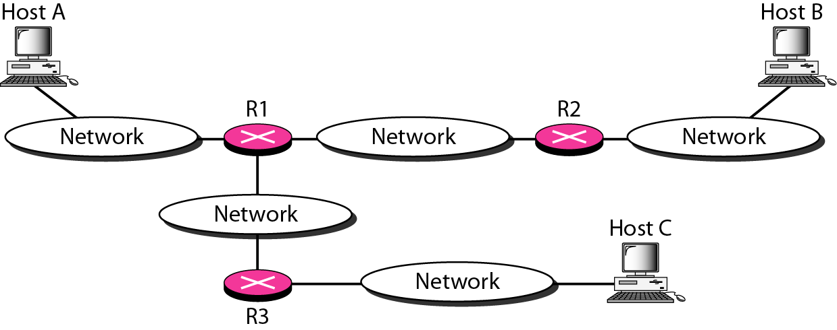
Figure 21.15 The traceroute program operation
21.<number>

Slide 34
“Real” Internet delays and routes
What do “real” Internet delay & loss look like?
Traceroute program: provides delay measurement from source to router along end-end Internet path towards destination. For all i:
  sends three packets that will reach router i on path towards destination
  router i will return packets to sender
  sender times interval between transmission and reply.
3 probes
3 probes
3 probes

Slide 35
Traceroute Commands
Under Windows: “tracert”
Under Unix: “traceroute”
You can try it on eustis.eecs.ucf.edu

Slide 36
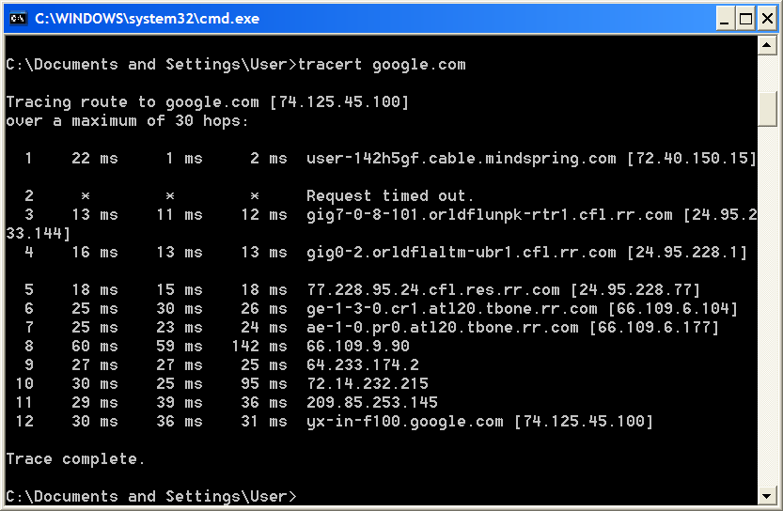
Traceroute from My Home Computer

Slide 37
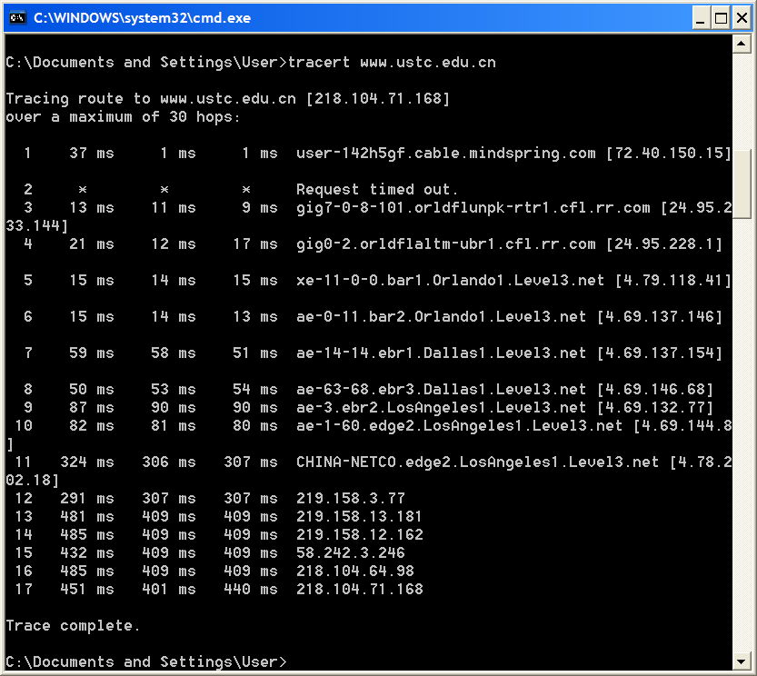

Slide 38
21-3 IGMP (Internet Group Management Protocol)
The IP protocol can be involved in two types of communication: unicasting and multicasting. The Internet Group Management Protocol (IGMP) is one of the necessary, but not sufficient, protocols that is involved in multicasting. IGMP is a companion to the IP protocol.
21.<number>

